Slide 1
Project: Bounce Back
By Cyrus Mak and Noah Pidding

Slide 2
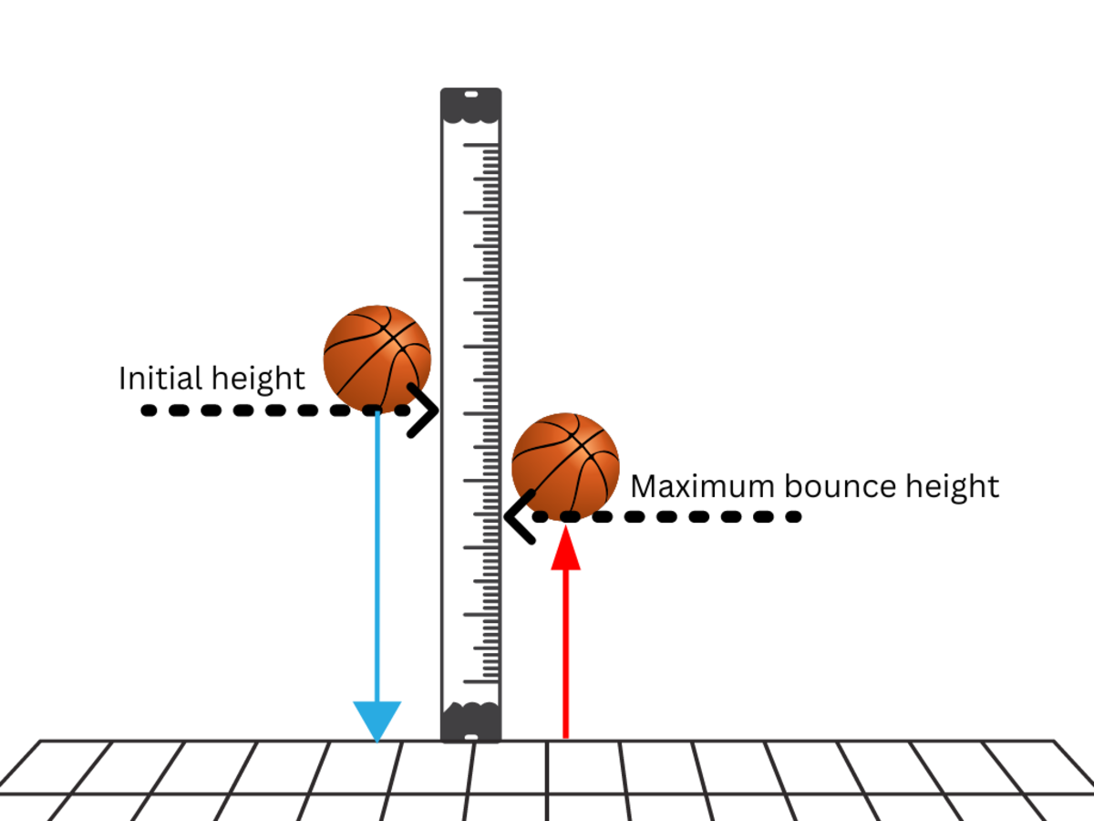
Objective:
Determine how the type of surface affects the height that a ball bounces to better understand how material can affect energy transfer.

Slide 3
Hypothesis:
A ball will bounce higher when dropped on a hard surface and lower on a softer surface

Slide 4
Testing:
Independent variable: types of surface (3)
Dependent variable: height
Controlled variables: ball used, drop height, measurement, weather/temperature conditions
# of trials: 30 per surface
Control test: concrete

